Slide 1
Chapter 3
Software Requirement Analysis and Specification

Slide 2
What is a requirement?
It may range from a high-level abstract statement of a service
System constraint to a detailed mathematical functional specification.
This is unavoidable as requirements may serve a dual function
May be the basis for a bid for a contract - therefore must be open to interpretation
May be the basis for the contract itself - therefore must be defined in detail;
Both these statements may be called requirements.

Slide 3
Types of requirement
User requirements
Statements in natural language plus diagrams of the services the system provides and its operational constraints. Written for customers.
System requirements
A structured document setting out detailed descriptions of the system’s functions, services and operational constraints. Defines what should be implemented so may be part of a contract between client and contractor.

Slide 4
System stakeholders
Any person or organization who is affected by the system in some way and so who has a legitimate interest
Stakeholder types
End users
System managers
System owners
External stakeholders

Slide 5
Functional and non-functional requirements

Slide 6
Functional and non-functional requirements
Functional requirements
Statements of services the system should provide, how the system should react to particular inputs and how the system should behave in particular situations.
May state what the system should not do.
Non-functional requirements
Constraints on the services or functions offered by the system such as timing constraints, constraints on the development process, standards, etc.
Often apply to the system as a whole rather than individual features or services.
Domain requirements
Constraints on the system from the domain of operation

Slide 7
Functional requirements
Describe functionality or system services.
Depend on the type of software, expected users and the type of system where the software is used.
Functional user requirements may be high-level statements of what the system should do.
Functional system requirements should describe the system services in detail.

Slide 8
Requirements imprecision
Problems arise when functional requirements are not precisely stated.
Ambiguous requirements may be interpreted in different ways by developers and users.
Consider the term ‘search’ in requirement 1
User intention – search for a patient name across all appointments in all clinics;
Developer interpretation – search for a patient name in an individual clinic. User chooses clinic then search.

Slide 9
Requirements completeness and consistency
In principle, requirements should be both complete and consistent.
Complete
They should include descriptions of all facilities required.
Consistent
There should be no conflicts or contradictions in the descriptions of the system facilities.
In practice, because of system and environmental complexity, it is impossible to produce a complete and consistent requirements document.

Slide 10
Non-functional requirements
These define system properties and constraints e.g. reliability, response time and storage requirements. Constraints are I/O device capability, system representations, etc.
Process requirements may also be specified mandating a particular IDE, programming language or development method.
Non-functional requirements may be more critical than functional requirements. If these are not met, the system may be useless.

Slide 11
Non-functional requirements implementation
Non-functional requirements may affect the overall architecture of a system rather than the individual components.
For example, to ensure that performance requirements are met, you may have to organize the system to minimize communications between components.
A single non-functional requirement, such as a security requirement, may generate a number of related functional requirements that define system services that are required.
It may also generate requirements that restrict existing requirements.

Slide 12
Non-functional classifications
Product requirements
Requirements which specify that the delivered product must behave in a particular way e.g. execution speed, reliability, etc.
Organisational requirements
Requirements which are a consequence of organisational policies and procedures e.g. process standards used, implementation requirements, etc.
External requirements
Requirements which arise from factors which are external to the system and its development process e.g. interoperability requirements, legislative requirements, etc.

Slide 13
Goals and requirements
Non-functional requirements may be very difficult to state precisely and imprecise requirements may be difficult to verify.
Goal
A general intention of the user such as ease of use.
Verifiable non-functional requirement
A statement using some measure that can be objectively tested.
Goals are helpful to developers as they convey the intentions of the system users.

Slide 14
Usability requirements
The system should be easy to use by medical staff and should be organized in such a way that user errors are minimized. (Goal)
Medical staff shall be able to use all the system functions after four hours of training. After this training, the average number of errors made by experienced users shall not exceed two per hour of system use. (Testable non-functional requirement)

Slide 15
Metrics for specifying nonfunctional requirements
Property | Measure
Speed | Processed transactions/second User/event response time Screen refresh time
Size | Mbytes Number of ROM chips
Ease of use | Training time Number of help frames
Reliability | Mean time to failure Probability of unavailability Rate of failure occurrence Availability
Robustness | Time to restart after failure Percentage of events causing failure Probability of data corruption on failure
Portability | Percentage of target dependent statements Number of target systems

Slide 16
Requirements engineering processes

Slide 17
Requirements engineering processes
The processes used for RE vary widely depending on the application domain, the people involved and the organisation developing the requirements.
However, there are a number of generic activities common to all processes
Feasibility Study
Requirements elicitation
Requirements analysis
Requirements validation
Requirements management.
In practice, RE is an iterative activity in which these processes are interleaved.

Slide 18
A. Feasibility Study
A feasibility Study in Software Engineering is a study to evaluate the feasibility of a proposed project or system.
A feasibility study is one of stage among important stages of the Software Project Management Process.
It is a measure of the software product in terms of how beneficial product development will be for the organization from a practical point of view.
A feasibility study is carried out based on many purposes to analyze whether the software product will be right in terms of development, implantation, the contribution of the project to the organization etc.

Slide 19
A. Feasibility Study
1.Technical Feasibility
Current resources hardware or software
Technical skills and capabilities
2.Economic Feasibility
Cost incurred on software development
Cost of hardware ,software, development team, and training.
3. Operational Feasibility
Depends on human resource and whether software will operate after it is developed.

Slide 20
B. Requirement Elicitation
Requirements are Discovered , Articulated and Revealed from stake holders
It is perhaps the most difficult, most error-prone and most communication intensive aspect of software development.
It can be successful only through an effective customer-developer partnership.
It is needed to know what the users really need.

Slide 21
Requirements elicitation Activities:
Knowledge of the overall area where the systems is applied.
The details of the precise customer problem where the system are going to be applied must be understood.
Interaction of system with external requirements.
Detailed investigation of user needs.
Define the constraints for system development.

Slide 22
Requirements elicitation Methods:
Interviews
Brainstorming Sessions
Facilitated Application Specification Technique (FAST)
Quality Function Deployment (QFD)
Use Case Approach
The success of an elicitation technique used depends on the maturity of the analyst, developers, users, and the customer involved.

Slide 23
1. Interviews:
Objective of conducting an interview is to understand the customer’s expectations from the software.
It is impossible to interview every stakeholder hence representatives from groups are selected based on their expertise and credibility.
Interviews maybe be open-ended or structured.
In open-ended interviews there is no pre-set agenda.
Context free questions may be asked to understand the problem.
In structured interview, agenda of fairly open questions is prepared. Sometimes a proper questionnaire is designed for the interview.

Slide 24
2. Brainstorming Sessions:
It is a group technique used to understand the requirement.
It promotes creative thinking, generates new ideas and provide platform to share views and difficulties of implementations.
A highly trained facilitator is required to handle group bias and group conflicts.
Every idea is documented so that everyone can see it.
Finally, a document is prepared which consists of the list of requirements and their priority if possible.

Slide 25
3. Facilitated Application Specification Technique(FAST):
It’s objective is to bridge the expectation gap – difference between what the developers think they are supposed to build and what customers think they are going to get.
A team-oriented approach is developed for requirements gathering. Each attendee is asked to make a list of objects ,functions and constraints.
List of object consist of objects used in the system, object that are produced by system and the object that surround the system.
List of service consist of all the required functionalities that manipulate or interact with the object.
List of constraint consist of all the constraint of the system such as cost, rules, memory requirements, speed, accuracy etc.
Each participant prepares his/her list, different lists are then combined, redundant entries are eliminated, team is divided into smaller sub-teams to develop mini-specifications and finally a draft of specifications is written down using all the inputs from the meeting.

Slide 26
4. Quality Function Deployment
In this technique customer satisfaction is of prime concern, hence it emphasizes on the requirements which are valuable to the customer. Three types of requirements are identified –
1. Normal requirements In this the objective and goals of the proposed software are discussed with the customer.
Example – normal requirements for a result management system may be entry of marks, calculation of results, etc
2. Expected requirements These requirements are so obvious that the customer need not explicitly state them.
Example – protection from unauthorized access.
3. Exciting requirements It includes features that are beyond customer’s expectations and prove to be very satisfying when present.
Example – when unauthorized access is detected, it should backup and shutdown all processes.

Slide 27
5. Use Case Approach:
This technique combines text and pictures to provide a better understanding of the requirements.
The use cases describe the ‘what’, of a system and not ‘how’. Hence, they only give a functional view of the system. The components of the use case design includes three major things – Actor, Use cases, use case diagram.
1. Actor It is the external agent that lies outside the system but interacts with it in some way. An actor maybe a person, machine etc. It is represented as a stick figure. Actors can be primary actors or secondary actors.
Primary actors – It requires assistance from the system to achieve a goal.
Secondary actor – It is an actor from which the system needs assistance.

Slide 28
5. Use Case Approach:
2. Use cases – They describe the sequence of interactions between actors and the system. They capture who(actors) do what(interaction) with the system. A complete set of use cases specifies all possible ways to use the system.
3. A use case diagram
Graphically represents what happens when an actor interacts with a system. It captures the functional aspect of the system.
A stick figure is used to represent an actor.
An oval is used to represent a use case.
A line is used to represent a relationship between an actor and a use case.

Slide 29
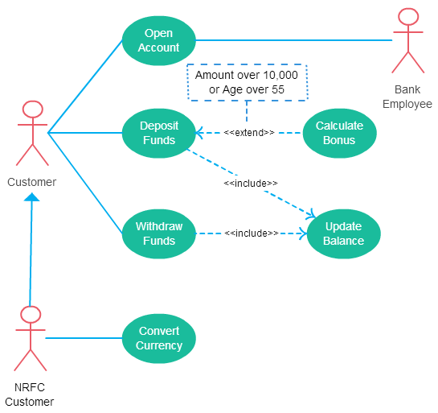
Use Case Diagram

Slide 30
6. Ethnography
Ethnography, within the realm of requirements elicitation, refers to a qualitative research approach that deeply immerses researchers in the natural environment of their subjects to observe and understand their behaviors, practices, and interactions with technology.
This anthropological method is adapted to software development to gain insights into user needs, experiences, and the context in which a system will operate.
It involves studying users in their work or life settings rather than in artificial environments or laboratory conditions.

Slide 31
C. Requirement analysis
Requirement analysis is significant and essential activity after elicitation.
Analyze, refine, and scrutinize the gathered requirements to make consistent and unambiguous requirements.
Provide a graphical view of the entire system.
After the completion of the analysis, it is expected that the understandability of the project may improve significantly.
Here, we may also use the interaction with the customer to clarify points of confusion and to understand which requirements are more important than others.

Slide 32
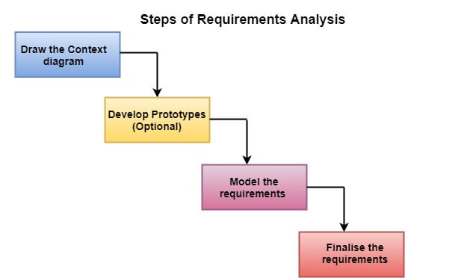
C. Requirement analysis

Slide 33
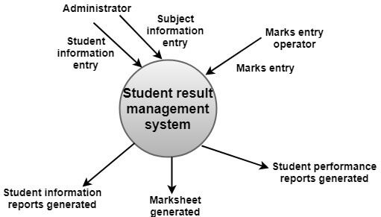
i) Draw the context diagram:
The context diagram is a simple model that defines the boundaries and interfaces of the proposed systems with the external world.
It identifies the entities outside the proposed system that interact with the system.
The context diagram of student result management system is given below:

Slide 34
(ii) Development of a Prototype (optional):
One effective way to find out what the customer wants is to construct a prototype, something that looks and preferably acts as part of the system they say they want.
We can use their feedback to modify the prototype until the customer is satisfied continuously.
Hence, the prototype helps the client to visualize the proposed system and increase the understanding of the requirements.
When developers and users are not sure about some of the elements, a prototype may help both the parties to take a final decision.

Slide 35
(iii) Model the requirements:
This process usually consists of various graphical representations of the functions, data entities, external entities, and the relationships between them.
The graphical view may help to find incorrect, inconsistent, missing, and superfluous requirements.
Such models include the Data Flow diagram, Entity-Relationship diagram, Data Dictionaries, State-transition diagrams, etc.

Slide 36
(iv) Finalize the requirements:
After modeling the requirements, we will have a better understanding of the system behavior.
The inconsistencies and ambiguities have been identified and corrected.
The flow of data amongst various modules has been analyzed. Elicitation and analyze activities have provided better insight into the system.
Now we finalize the analyzed requirements, and the next step is to document these requirements in a prescribed format.

Slide 37
D. Requirements verification and validation:
Verification: It refers to the set of tasks that ensures that the software correctly implements a specific function.
Validation: It refers to a different set of tasks that ensures that the software that has been built is traceable to customer requirements.
If requirements are not validated, errors in the requirement definitions would propagate to the successive stages resulting in a lot of modification and rework.

Slide 38
Conti..
The main steps for this process include:
The requirements should be consistent with all the other requirements i.e no two requirements should conflict with each other.
The requirements should be complete in every sense.
The requirements should be practically achievable.

Slide 39
Requirements checking
Validity:- Does the system provide the functions which best support the customer’s needs?
Consistency:- Are there any requirements conflicts?
Completeness:- Are all functions required by the customer included?
Realism:- Can the requirements be implemented given available budget and technology
Verifiability:- Can the requirements be checked?

Slide 40
Requirements validation Techniques:
Plan Review
Distribute SRS Document
Read SRS Document
Organize Review meeting
Follow-up action
Revise SRS Documents

Slide 41
Requirements reviews
Regular reviews should be held while the requirements definition is being formulated.
Both client and contractor staff should be involved in reviews.
Reviews may be formal (with completed documents) or informal. Good communications between developers, customers and users can resolve problems at an early stage.

Slide 42
Review checks
Verifiability
Is the requirement realistically testable?
Comprehensibility
Is the requirement properly understood?
Traceability
Is the origin of the requirement clearly stated?
Adaptability
Can the requirement be changed without a large impact on other requirements?

Slide 43
E. Requirements management:
Requirements management is the process of managing changing requirements during the requirements engineering process and system development.
New requirements emerge as a system is being developed and after it has gone into use.
Need to keep track of individual requirements and maintain links between dependent requirements so that you can assess the impact of requirements changes.
Establish a formal process for making change proposals and linking these to system requirements.

Slide 44
Requirements management planning
Establishes the level of requirements management detail that is required.
Requirements management decisions:
Requirements identification Each requirement must be uniquely identified so that it can be cross-referenced with other requirements.
A change management process This is the set of activities that assess the impact and cost of changes..
Traceability policies These policies define the relationships between each requirement and the system design that should be recorded.
Tool support Tools that may be used range from specialist requirements management systems to spreadsheets and simple database systems

Slide 45
SRS Document
What is SRS?
A software requirements specification (SRS) is a description of a software system to be developed.
It lays out functional and non-functional requirements and may include a set of use cases that describe user interactions that the software must provide.
Why SRS?
In order to fully understand one’s project, it is very important that they come up with an SRS listing out their requirements, how are they going to meet them and how will they complete the project.
It helps the team to save upon their time as they are able to comprehend how are going to go about the project.
Doing this also enables the team to find out about the limitations and risks early on.

Slide 46
Quality Characteristics of a good SRS
Correctness: User review is used to ensure the correctness of requirements stated in the SRS. SRS is said to be correct if it covers all the requirements that are actually expected from the system.
Completeness: Completeness of SRS indicates every sense of completion including the numbering of all the pages, resolving the to be determined parts to as much extent as possible as well as covering all the functional and non-functional requirements properly.
Consistency: Requirements in SRS are said to be consistent if there are no conflicts between any set of requirements. Examples of conflict include differences in terminologies used at separate places, logical conflicts like time period of report generation, etc.

Slide 47
Quality Characteristics of a good SRS
Unambiguousness: A SRS is said to be unambiguous if all the requirements stated have only 1 interpretation. Some of the ways to prevent unambiguousness include the use of modelling techniques like ER diagrams, proper reviews and buddy checks, etc.
Ranking for importance and stability: There should a criterion to classify the requirements as less or more important or more specifically as desirable or essential. An identifier mark can be used with every requirement to indicate its rank or stability.
Modifiability: SRS should be made as modifiable as possible and should be capable of easily accepting changes to the system to some extent. Modifications should be properly indexed and cross-referenced.

Slide 48
Quality Characteristics of a good SRS
Verifiability: An SRS is verifiable if there exists a specific technique to quantifiably measure the extent to which every requirement is met by the system. For example, a requirement starting that the system must be user-friendly is not verifiable and listing such requirements should be avoided.
Traceability: One should be able to trace a requirement to design component and then to code segment in the program. Similarly, one should be able to trace a requirement to the corresponding test cases.
Design Independence: There should be an option to choose from multiple design alternatives for the final system. More specifically, the SRS should not include any implementation details.

